Slide 1
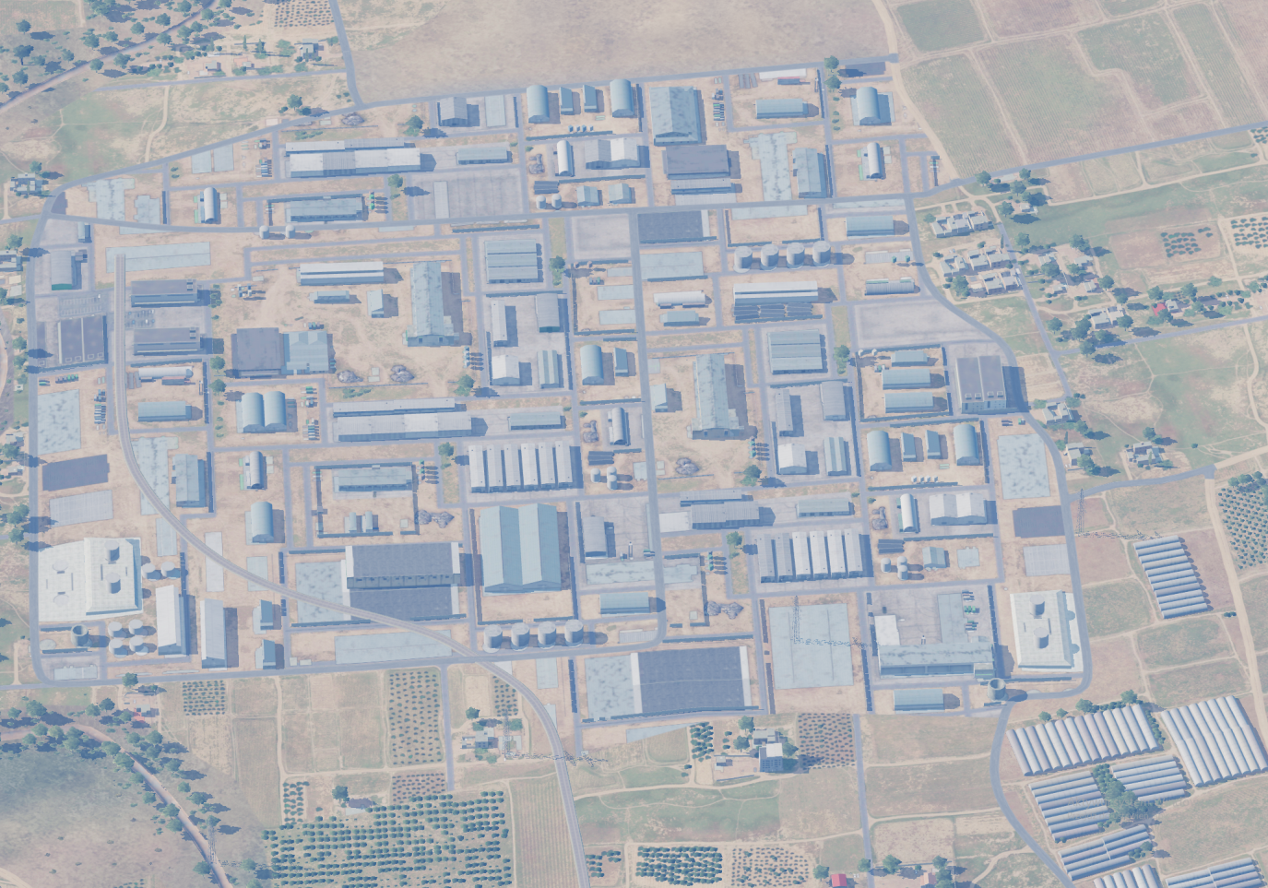
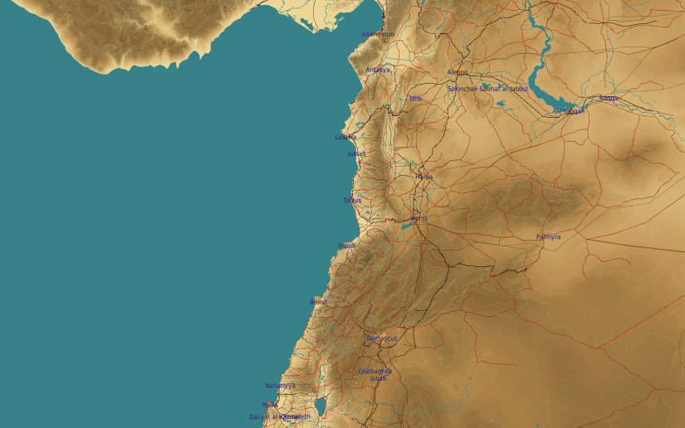
OPARTGT018 AMMUNITION FACTORY
N
4
18
2
3
DESIRED POINT of IMPACT:
DPI 1 - N35 10.208 E 36 43.665 / 876ft/ GBU-32/GBU-16
DPI 2 - N35 10.306 E 36 43.785 / 906ft/GBU-38/GBU-12
DPI 3 - N35 10.300 E 36 43.941 / 958ft/ GBU-32/GBU-16
DPI 4 - N35 10.477 E 36 43.780 / 922ft/ GBU-32/GBU-16
1
civilian property outside southern and eastern perimeter of the factory compound.
siloses within the factory compound contain flammables and industrial gas. (all marked in yellow)

